Slide 1
Social Media Campaign Analytics
Author: Temitopeoluwa Giwa Contributor: Makun

Slide 2
Social Media Campaign Analytics
Objective
Social Media Interaction Story
Recommendations
Conclusion

Slide 3
OBJECTIVE
Discover trends and patterns in how people interact with our social media content, helping us make better decisions in our online marketing and customer engagement strategies.

Slide 4
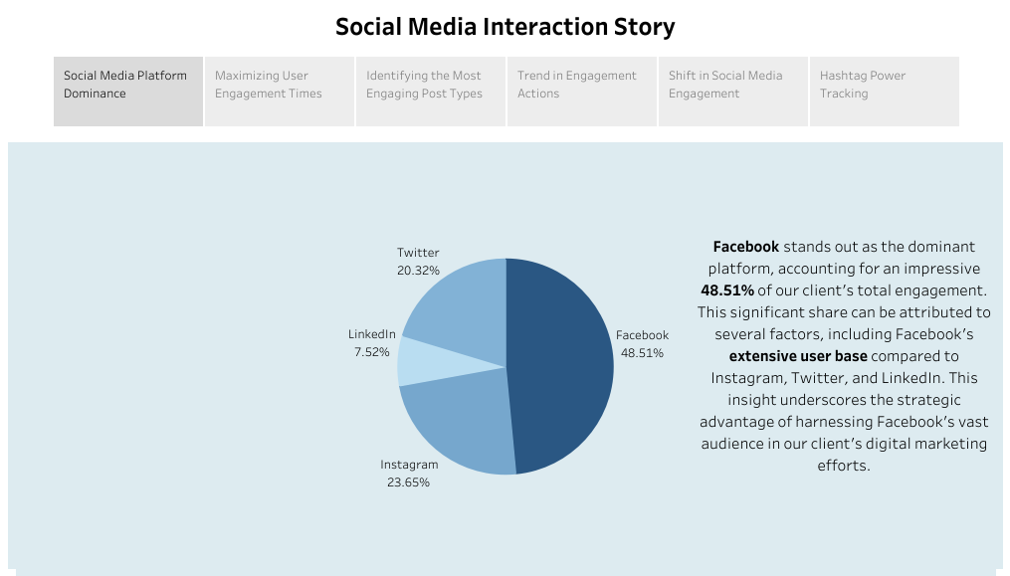

Slide 5
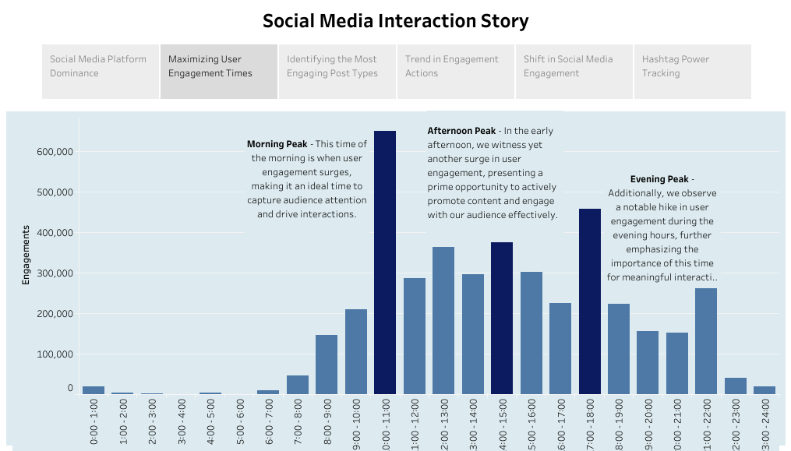

Slide 6
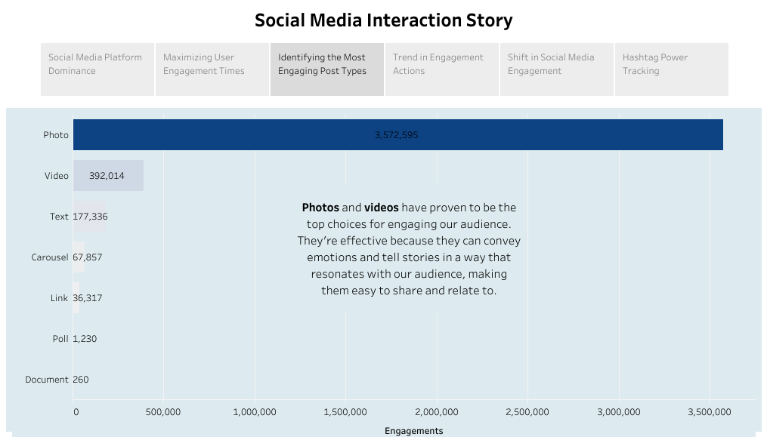

Slide 7
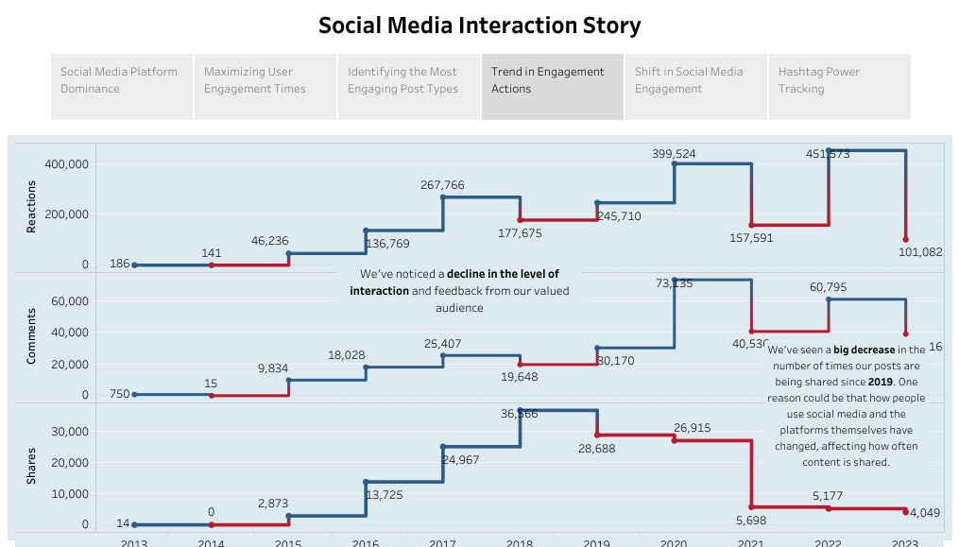

Slide 8
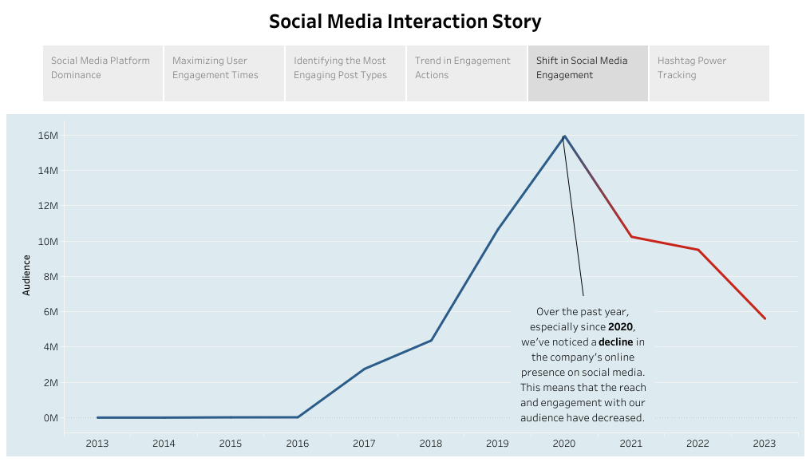

Slide 9
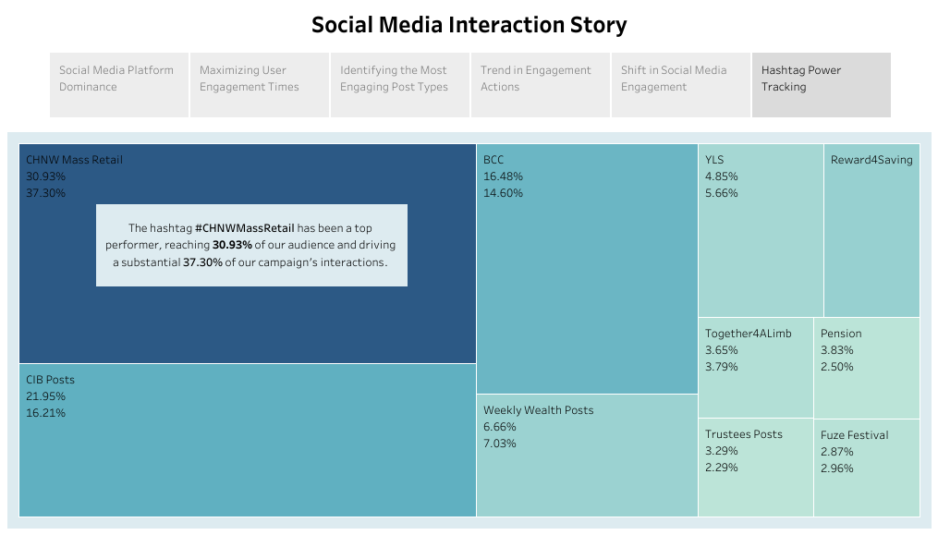

Slide 10
Recommendations
Post more frequently, especially during peak activity times, and actively respond to comments and messages to reconnect with and engage our online audience.
Use #CHNWMassRetail more frequently in our posts and explore similar effective hashtags to boost content visibility and interaction.
Prioritize sharing engaging photos and videos while experimenting with different visual content formats like live videos and creative graphics to maintain audience interest.

Slide 11
CONCLUSION
This social media analytics project has provided us with valuable insights into how our audience interacts with our content. This knowledge can be leveraged to improve our online marketing and customer engagement strategies, helping us achieve our specific business goals.

